Slide 1

Java for Beginners
British School of Beijing
Mr. Myran Teasdale

Slide 2
Program Construction in Java
2

Slide 3
Topic 4 Part 0???????
Get used to it.
Computer scientists start counting at zero.
This will cover Topic 4.3 and Option D OOP
3

Slide 4
What is a program?
A list of instructions telling the computer what to do.
It must be precise and its semantics and syntax, (logic and grammar/spelling) must be correct if translation into machine code is to succeed.
4

Slide 5
Why Java?
Java has these advantages over other languages:
it is a high-level programming language (closer to human language than machine code);
it is event-driven (it can respond to user mouse clicks and key presses);
5

Slide 6
Why Java?
programs can come as two types: applications (run on their own) and applets (run in a web browser, making Java very web user-friendly);
executables in other languages have too much access to the system and can't be trusted - the sandboxing in Java means it is difficult to write a virus or crash the whole system;
6

Slide 7
Why Java?
it is effectively a platform in itself and so is platform-independent (programs will run on Windows, Macs, Linux, etc.) - the Java compiler actually creates byte code which is standard and will be converted to the machine's native machine code at run time;
7

Slide 8
Why Java?
it is simpler than other languages, so easier to learn, so fewer bugs and bugs are easier to spot;
it is object-oriented which makes it easier to conceive and work with GUI (window- based) interfaces;
8

Slide 9
Why Java?
it is multithreaded , meaning programs can run several tasks simultaneously, (as can Windows of course), unlike older style procedural programs;
the different files (classes) of a Java project are independent but dynamically linked so they can use each other automatically when required;
9

Slide 10
Why Java?
memory allocation is more efficient than in other languages (Java uses what is called garbage collection to liberate memory that is no longer needed); and
the IBO says we must!
10

Slide 11
Pseudocode
An artificial simplified programming ‘language’ used to describe algorithms without using the rules of any particular programming language.
During the development of an algorithm, pseudocode often contains sections of natural language that will be replaced later.
11

Slide 12
What do I need for Java?
JDK
IDE
Java!
JDK (Java Development Kit) – download from Oracle
IDE (Integrated Development Environment) Many options:
Eclipse (eclipse.org) – PC and Mac version
BlueJ (bluej.org)
Netbeans (netbeans.org) ALL FREE!

Slide 13
3 Laws of Java
Every line ends with a ; unless the next symbol is a {
Every { has a }
Classes start with capital letters, methods and variables start with lower case letters

Slide 14
Syntax rules
Classes start capital letters and have no ( )
Methods start lowercase letters and have a ( )
Variables always start with a lowercase letter
= means ‘gets the value of’
== means ‘equals’ when comparing numbers
.equals() means ‘equals’ when comparing words

Slide 15
Java’s reserved words
Some words, called keywords, e.g. class, true are reserved by Java.
This means you cannot use them for your own purposes e.g as a variable name.
15

Slide 16

Java’s structure
Java programs are called ‘classes’
They exist inside a container called a project
All classes have at least one method called main()
Project: NinjaTurtles
Class: NinjaTurtles
Method: main()
We write our ‘code’ here

Slide 17
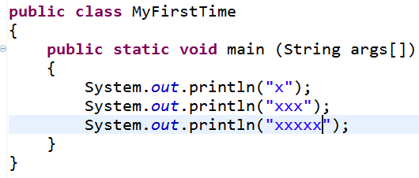
Java class example

Slide 18
Java class example
Class name
Main method

Slide 19
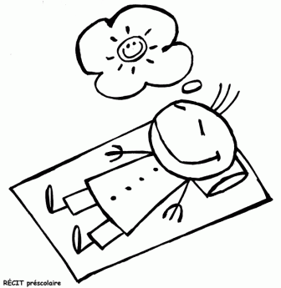
Don’t worry!
The IDE (Eclipse) automatically makes all the ‘gunk’ at the top public this, void main that…

Slide 20
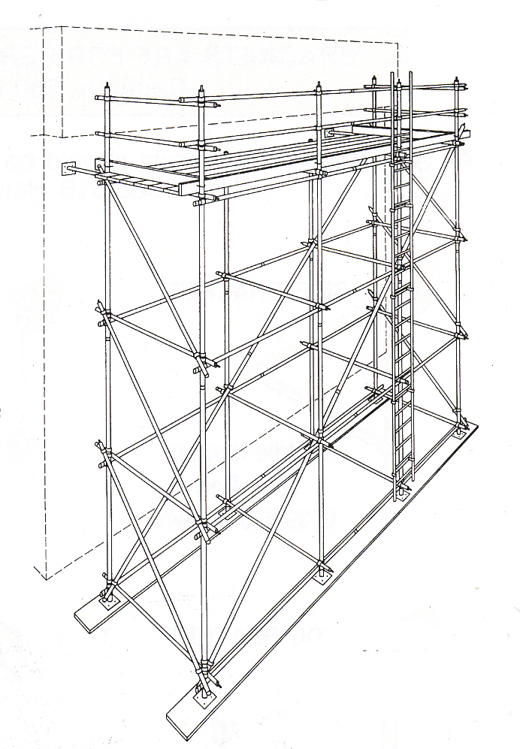
Levels of coding
Learning to program can be difficult if you don’t learn things in the right order.
Each level depends on a firm understanding of the previous level.
It works!

Slide 21
Levels of Java coding
1: Syntax, laws, variables, output
2: Input, calculations, String manipulation
3: Selection (IF-ELSE)
4: Iteration/Loops (FOR/WHILE)
5: Complex algorithms
6: Arrays
7: File management
8: Methods
9: Objects and classes
10: Graphical user interface elements

